Slide 1
Props 11 & 14
The most impactful decision for the future of our communities

Slide 2


What are the propositions?
Prop 14
Prop 11
Creates a school district for Eagle Mountain, Saratoga Springs, Cedar Fort & Fairfield
Would be the 10th largest in Utah
Fast growing tax base
Creates a school district for Lehi, American Fork, Highland, Alpine, Cedar Hills, and the Suncrest neighborhood of Draper (in Utah County)
Would be the 6th largest in Utah
If either proposition passes, Alpine School District will be dissolved and we will have either 2 or 3 new school districts starting in 2027

Slide 3
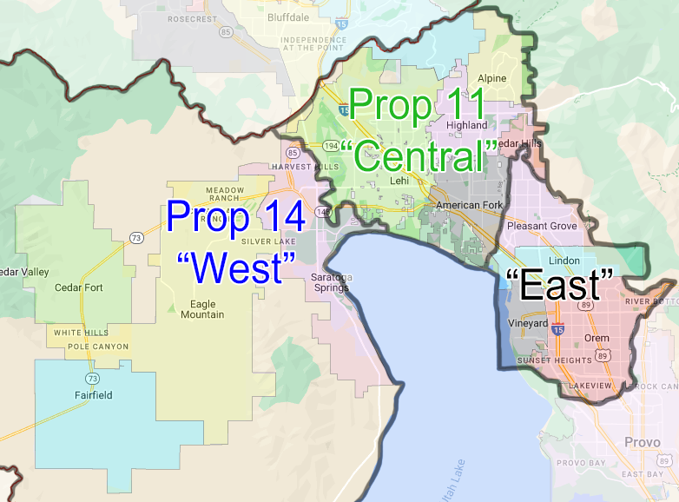
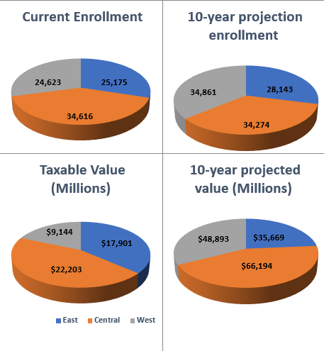
Potential New Districts

Slide 4
Why Split ASD?
Largest district in Utah by far:
  85,000 students, 92 schools
  Board members represent 12+ schools and 60,000+ residents each
  Average is 13k in Utah, <4k in US
Is bigger better?
  Studies show “sweet spot” for district size is ~10k – 40k
  Districts over 50K experience “diseconomies of scale”
    Overhead costs are higher
    Less transparency
    More middle management, bureaucracy, red tape
  Lower equity for programs and funding
    Pits communities against each other

Slide 5
Why Split ASD?
Community needs are different
  West side has overcrowded schools (3K+ HS, 1K+ elem)
    Schools aren’t being built fast enough
  East side has seismically unstable schools, small enrollments
    Seismic issues aren’t getting fixed (known for 20 years now)
    Schools being closed
  Central pays the most in taxes, but receives the least for students
  Opportunities for programs are not available or being taken away

Slide 6
Why Split ASD?
Bond not passing
  $595 million
  Didn’t address all needs, communities didn’t see the value
  No guarantee that the next bond will pass
Taxes going up
  ASD raised taxes 12.2% or ~$100 per house per year in 2024
  6 tax increases in 10 years

Slide 7
How will a split affect residents in West?
Study done by LRB Public Finance Advisors for West area:
  Initial increase in taxes to build needed schools and facilities
  Costs decrease quickly over the next few years
  Localized control
    7 board members instead of 2
  Better able to meet needs of students
Taxes will increase in ASD to build schools out west and pay for seismic issues in southeast
Split or no split, taxes will increase
2026: large portion of bond payments will drop off taxes
Ability to build needed schools without approval from other areas

Slide 8

How will a split affect residents in Central?
Study done by LRB Public Finance Advisors for Central area:
  Potential tax savings relative to ASD
  Opportunity for more local control
    7 board members instead of 2
  Better able to meet needs of students
2026: large portion of bond payments will drop off taxes
New bond for central will not have to pay for any costs in west or southeast

Slide 9
How will a split affect residents in southeast?
Ability to focus on fixing seismic issues
Addressing potential closure or consolidation of schools without interference from other areas
Ability to refit or sell old properties
2026 bond payments falling off will allow opportunity for new bond to fix schools, pay for startup costs
Would be 9th largest district in Utah

Slide 10
Consequences if we don’t split
Next bond might not pass, …again!
Board will continue to increase taxes to build schools, maintain benefits
Smaller schools will be closed, hurting communities (especially minorities, Title I)
Increased tension on school board and between communities

Slide 11
Feasible?
Multiple studies, including those done by ASD, demonstrate this is not just feasible, but thrivable
  West Interlocal Study, Central Interlocal Study, MGT Study, Orem DEC Study
About 70% of district revenue is from state income taxes, given on a per-pupil basis (WPU). A split wouldn’t change this
Largest property tax bases in ASD:
  Lehi (20%+)
  Orem (20%+)
  Eagle Mountain & Saratoga Springs (combined 20%+)

Slide 12
FAQs
Teachers
  Increased competition for teachers with multiple districts
  Competition will result in better pay as districts don’t want to lose teachers
  Teachers guaranteed salary, benefits, and seniority for 1 year after split
Students
  Can continue attending school of their choice
  Potential better access to programs

Slide 13
FAQs
Why is a 3 way split best?
  Divides up students and assets roughly equally
  Ensures that one area is not significantly disadvantaged over the others
  Potential for another split in future if only a 2 way now
  Doesn’t solve problems of representation and differences in community needs
Why split now?
  Differences between areas are great now, will only get worse
  Bonds won’t pass
  Board members disagreeing to work together
  Opponents never want a split. Will do and say anything to delay in an effort to prevent
  If not now, when?

Slide 14
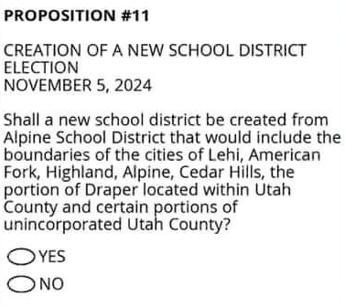
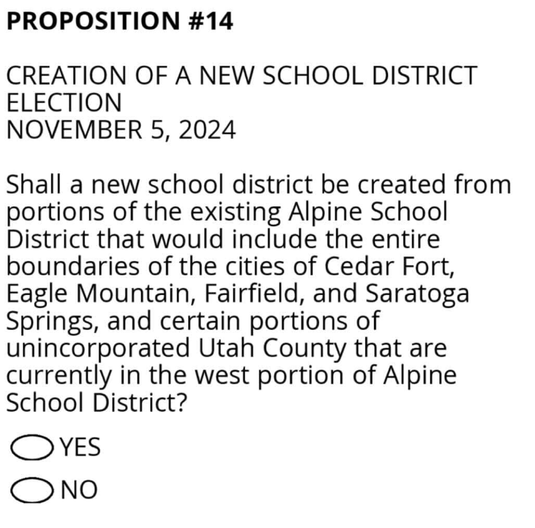
On your ballot
Lehi, American Fork, Highland, Alpine, Cedar Hills, Draper-Suncrest
Eagle Mountain, Saratoga Springs, Cedar Fort, Fairfield

Slide 15
More information
https://www.westdistrict.org/
https://prop11utah.org/
https://centralschooldistrict.org/
https://smallerschools.org/

